Slide 2
Workflow/overview:
Construct the MDP Model
Theoretical basis
Querying the model
Performing useful functions
Build a test heuristic/planner
Build a RL policy to learn a plan
Extend the system

Slide 3
Workflow/overview:
Construct the MDP Model
Theoretical basis
The transition model is defined as:
There are two actions: NS green or EW green
In a = NS green in one time step:
IF the previous time step was a NS green
The NS lanes each clear 5 vehicles and see P(2) vehicles enter
The EW lanes each see P(1) vehicles enter
If the previous time step was an EW green:
then hold for two time steps, simulating a yellow/all red
In a = EW green in one time step:
IF the previous time step was EW
Then EW clears 3 vehicles and see P(1) vehicles enter
The NS lanes see P(2) vehicles enter
If the previous time step was a NS
Then hold for two time steps, simulating a yellow/all red
Set a checkpoint that simulates a heuristic policy for 1000 time steps:
22APR24_benchmark

Slide 4
Workflow/overview:
Construct the MDP Model
Theoretical basis
Implement a Model-Based Solver
Problem: problem is intractable w/ number of potential states!
(200 openings/approach)^4*2 = 160000000*2
Solution?: Try to reduce to lumped number of cars in the NS and EW
Then it’s 100*100*2 and essentially a larger gridworld
And add a cap that at 100, just stays at 100
With SIGNIFICANT modifications, we’ve got something to run!
It’s limited to 50 instead. Once we get results on 50, will explore moving to 100
Note it jumps around a LOT. Try doing a heuristic on the first 100 training periods or so
Also add something such that evaluates the Q after every training period for plotting and we just want to return the final Q value

Slide 5
Final results:
Problem Statement (e.g. rough formulation as MDP, POMDP, or other optimization problem)
DONE! We formulated the problem and I can describe boiling it down
Description of methods you will use to solve the problem - this should include:
A description of a minimum working example that will be the first thing you try. This might be a baseline to compare other approaches against. If you are not able to get this working, you will receive a significant grade penalty.
EX1: We will use a heuristic planner – not working that well…
Plots: queue length curves DONE! Maybe do this on the 4-lane model For details
Reread the textbook and do this with values we like
A description of the main approach. This is an approach that you are confident that you can implement and think will solve the problem well. I will expect to see this implemented successfully in your final report.
We will use and compare 2 deep RL techniques I don’t think we need do…
Plots: learning curves and the queue length curves – finishing that now
Get this working comparable to the best approaches out there now
A description of a stretch goal. If you have enough time, this is the amazing innovative new solution you will explore.
Then consider a coordinated system

Slide 6
Outline:
Motivation – use this to cite number of traffic lights and benefits of appropriate timing
Define the MDP and introduce the terminology – S, T, A, R, gamma. Do this GENERALLY and only start subscribing numbers after pt 3.
Now define the typical traffic model - page ~350 in text
Do example 8.5 of text and simulate the MDP model with the conventional method
Show a plot of the lane lengths (FIG 1) – integral is the total queue length which is proportional to wait time. Use the original 4-lane approach model
Describe the downsides: high precision required; must vary by the time of day/day of week/month of year; not robust (FIG 2)
Now begin implementing a RL algorithm
Show issues with states scaling – describe modifications
Describe the algorithm
Learning curve (FIG 3)
Compare the traffic flow of a few Q’s (FIG 4)
Finally, compare the deployment of the conventional vs current in a head-to-head (FIG 5). Do a few runs to build up an SEM as well.
Final remarks – what are the limitations? how may we deploy this? Future work?
Division: 1-3 (30%), 4-6 (60%) 7 (10%)

Slide 7
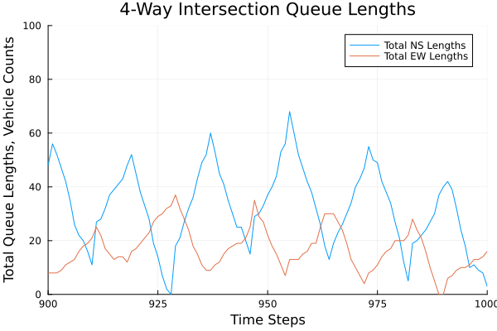
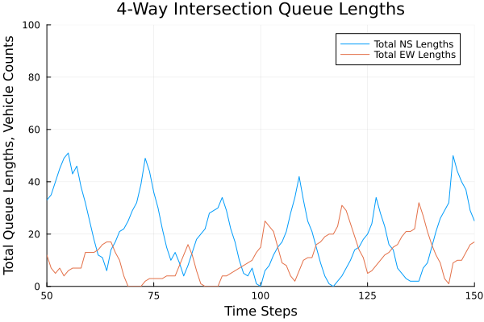
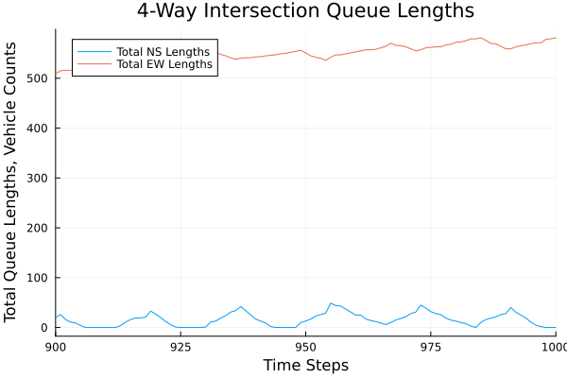
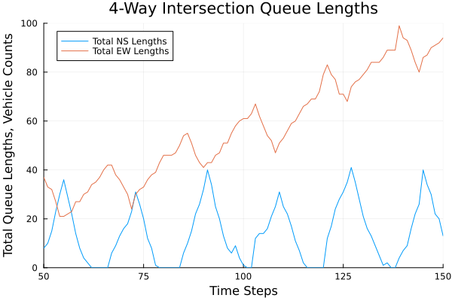
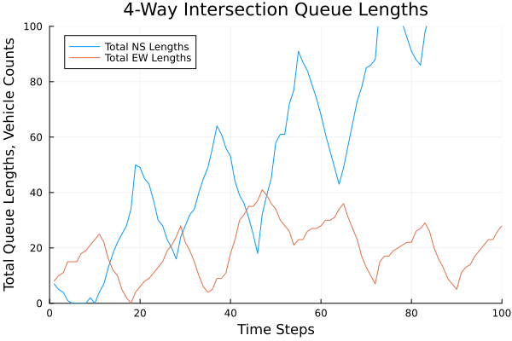
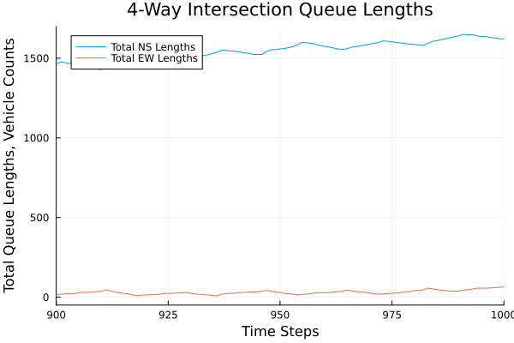
Figs 1, 2
Apply to the 4-lane approach and generate fig 1
Offset the numbers and generate fig 2 (set tcrit to 12) below (set NS in = Poisson(3))

Slide 8
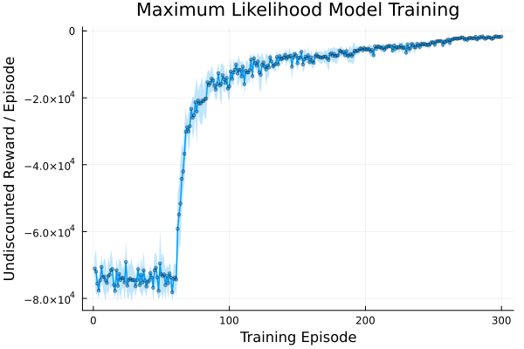

Slide 9
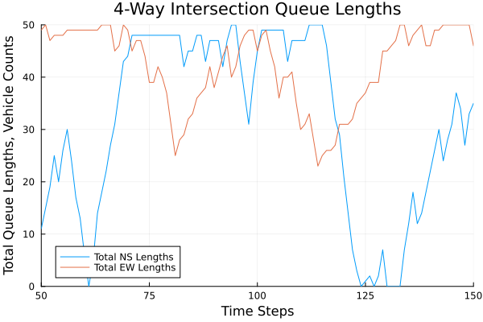
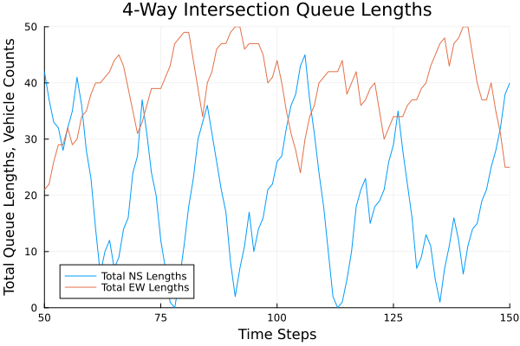
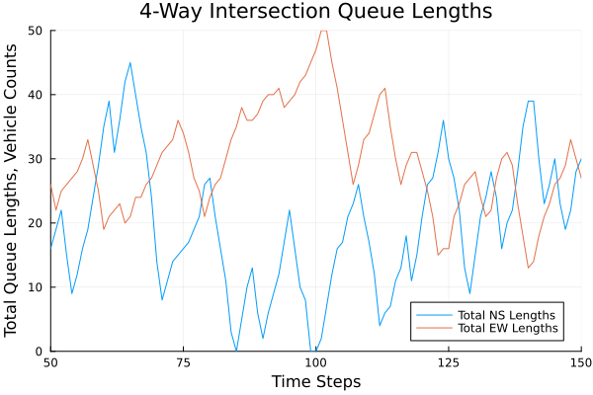
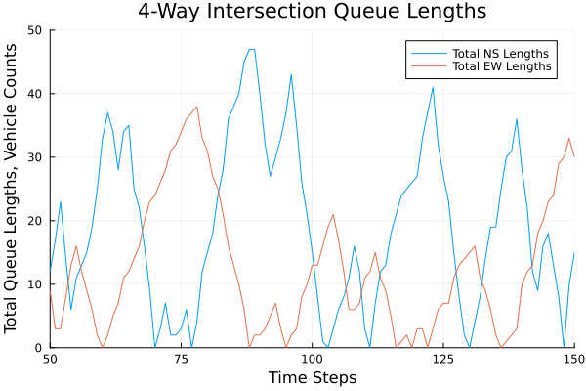
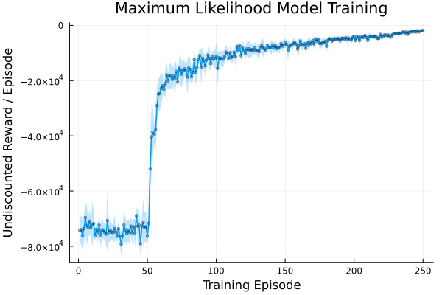
Figs 3, 4 (in order of 25% trained, 50%, 75%, 90%)

Slide 10
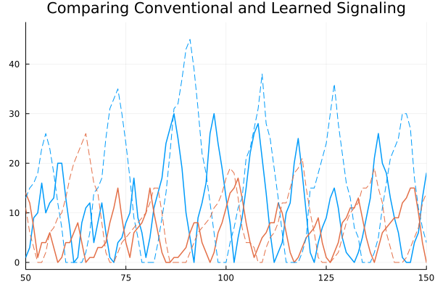

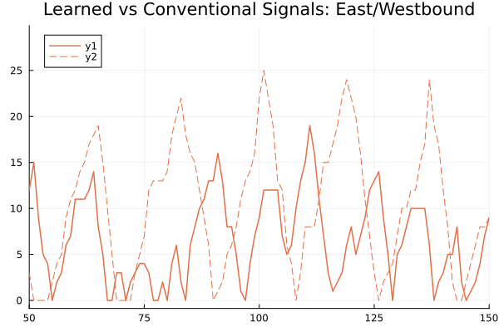
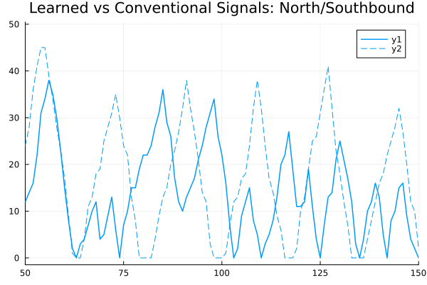
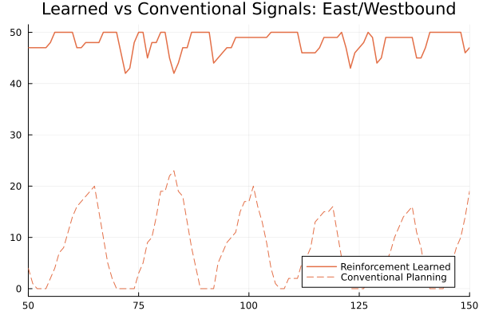
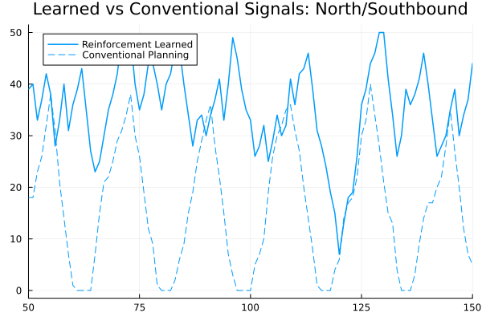
Figs 5: Note, take legends from the below plots. The mean and stds are over 50 rollouts TO DO: add redlight/greenlight points to the curves (for fun!)

Slide 11
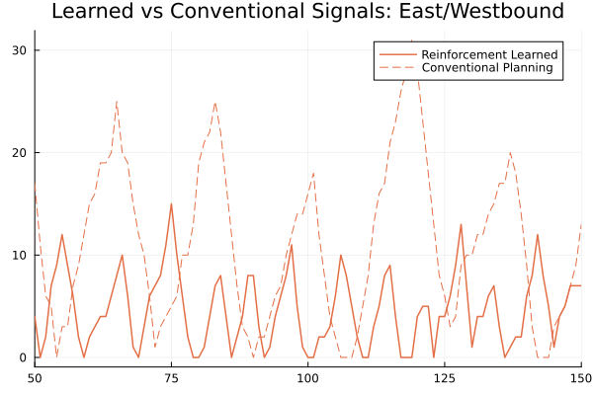
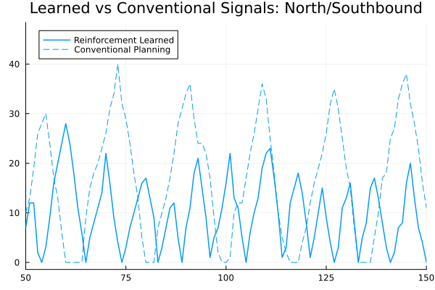

Slide 12
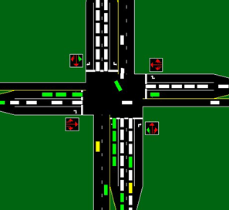
N/S Left turn lane groups: G
N/S straight and right lane groups: R

Slide 13




$φ_{1}$: NS Green
$$s_{N}$$
$$q_{E}$$
$φ_{2}$: EW Green

Slide 14
